Slide 1
Horizon Firm
3004
Hybrid
Designed with the finest attention to detail, every mattress in the Nature’s Spa collection features environmentally-friendly materials carefully selected to provide optimum pressure relief, temperature regulation and support.

Slide 2
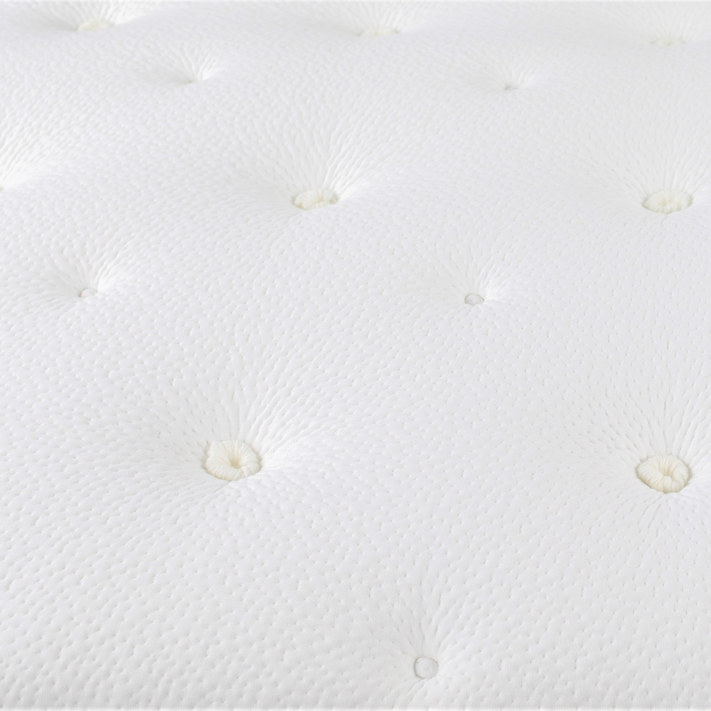
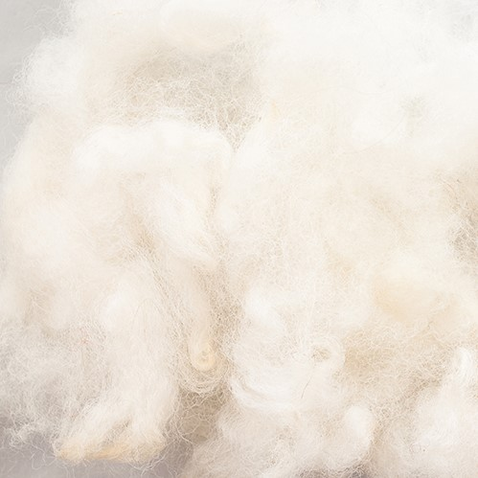
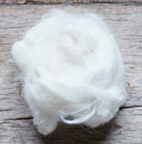
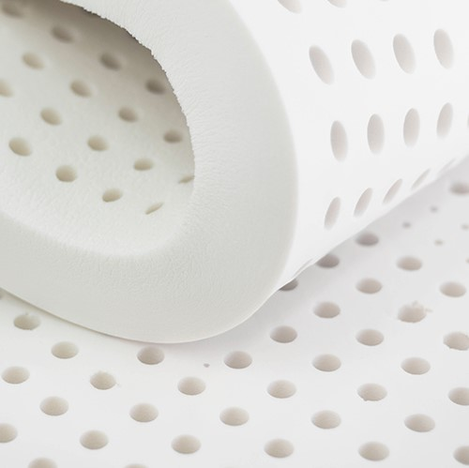
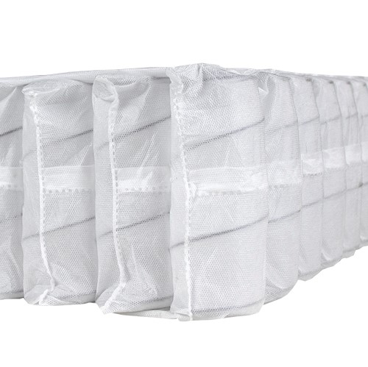
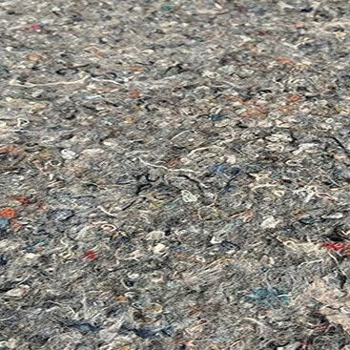
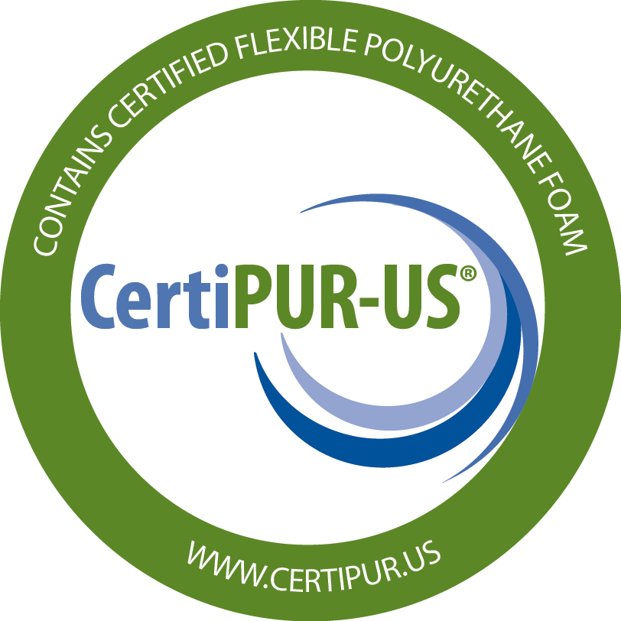
Horizon Firm 3004
Scan for
more info
Hybrid
SUSTAINABILITY FEATURES
Recycled Cotton Fabric
The most sustainable 100% recycled yarn on the market. All waste is collected during the production process and 80% is reused.
Silk, Wool & Cashmere Blend
Naturally regulates temperature and wicks away moisture. The perfect blend is added to the quilt to keep you comfortable, cool and dry.
Natural Cotton
High-quality, natural cotton fiber is lightweight, hypoallergenic, recyclable, biodegradable and keeps your sleeping environment cool and comfortable.
Natural Latex
Oeko-Tex certified, hypoallergenic and resistant to dust-mites, mold and mildew, it conforms to your unique shape and distributes weight evenly.
896 Firm, 13.75-Gauge 3-Zone Pocket Spring
The 896 firm 3-zone pocketed spring unit boasts 13.75-gauge springs for a firmer, deep-down support that gives you ideal comfort throughout the entire mattress.
Recycled Densified Fiber Pad
Made from 60% recycled bottles and provides optimal mattress support.
ADDITIONAL FEATURES
Copper, Silver & Gel Comfort Fiber
Antimicrobial, antibacterial, dust mite resistant, helps conduct heat from the top of the mattress
High Density Support Foam
Creates a firm sleeping surface and provides more support than standard foam.
Compression Hand Tufting
Hand Tufting compresses the mattress 2" creating loft that works against the body to reduce body impressions.
Cooling Gel Quilting Foam
Oeko-Tex certified quilting foam adds pressure relief and provides more support throughout the mattress.
Upholstery-Grade Foam Encasement
Permanently seals the innerspring 360 degrees around to deliver a durable, comfortable seating edge and 20% more sleeping area.
Adjustable Base Friendly
Amish Wood Foundation

Slide 3
Horizon Plush
3020
Hybrid
Designed with the finest attention to detail, every mattress in the Nature’s Spa collection features environmentally-friendly materials carefully selected to provide optimum pressure relief, temperature regulation and support.

Slide 4
Horizon Plush 3020
Scan for
more info
Hybrid
SUSTAINABILITY FEATURES
Recycled Cotton Fabric
The most sustainable 100% recycled yarn on the market. All waste is collected during the production process and 80% is reused.
Silk, Wool & Cashmere Blend
Naturally regulates temperature and wicks away moisture. The perfect blend is added to the quilt to keep you comfortable, cool and dry.
Natural Cotton
High-quality, natural cotton fiber is lightweight, hypoallergenic, recyclable, biodegradable and keeps your sleeping environment cool and comfortable.
Natural Latex
Oeko-Tex certified, hypoallergenic and resistant to dust-mites, mold and mildew, it conforms to your unique shape and distributes weight evenly.
702 High-Density Pocket Spring Unit
The high-density pocketed coil construction offers a firmer, deep-down support, more airflow, and ensures optimum support across the surface for proper spinal alignment.
Recycled Densified Fiber Pad
Made from 60% recycled bottles and provides optimal mattress support.
ADDITIONAL FEATURES
Copper, Silver & Gel Comfort Fiber
Antimicrobial, antibacterial, dust mite resistant, helps conduct heat from the top of the mattress
Compression Hand Tufting
Hand Tufting compresses the mattress 2" creating loft that works against the body to reduce body impressions.
Cooling Gel Quilting Foam
Oeko-Tex certified quilting foam adds pressure relief and provides more support throughout the mattress.
Upholstery-Grade Foam Encasement
Permanently seals the innerspring 360 degrees around to deliver a durable, comfortable seating edge and 20% more sleeping area.
Adjustable Base Friendly
Amish Wood Foundation

Slide 5
Heaven Luxury Firm
3006
Hybrid
Designed with the finest attention to detail, every mattress in the Nature’s Spa collection features environmentally-friendly materials carefully selected to provide optimum pressure relief, temperature regulation and support.

Slide 6
Heaven Luxury Firm 3006
Scan for
more info
Hybrid
SUSTAINABILITY FEATURES
Recycled Cotton Fabric
The most sustainable 100% recycled yarn on the market. All waste is collected during the production process and 80% is reused.
Silk, Wool & Cashmere Blend
Naturally regulates temperature and wicks away moisture. The perfect blend is added to the quilt to keep you comfortable, cool and dry.
Natural Cotton
High-quality, natural cotton fiber is lightweight, hypoallergenic, recyclable, biodegradable and keeps your sleeping environment cool and comfortable.
Natural Latex
Oeko-Tex certified, hypoallergenic and resistant to dust-mites, mold and mildew, it conforms to your unique shape and distributes weight evenly.
896 Firm, 13.75-Gauge 3-Zone Pocket Spring
The 896 firm 3-zone pocketed spring unit boasts 13.75-gauge springs for a firmer, deep-down support that gives you ideal comfort throughout the entire mattress.
Recycled Densified Fiber Pad
Made from 60% recycled bottles and provides optimal mattress support.
ADDITIONAL FEATURES
Copper, Silver & Gel Comfort Fiber
Antimicrobial, antibacterial, dust mite resistant, helps conduct heat from the top of the mattress
Compression Hand Tufting
Hand Tufting compresses the mattress 2" creating loft that works against the body to reduce body impressions.
Cooling Gel Quilting Foam
Oeko-Tex certified quilting foam adds pressure relief and provides more support throughout the mattress.
Upholstery-Grade Foam Encasement
Permanently seals the innerspring 360 degrees around to deliver a durable, comfortable seating edge and 20% more sleeping area.
Adjustable Base Friendly
Amish Wood Foundation

Slide 7
Holistic
Plush Euro Top
3008
Hybrid
Designed with the finest attention to detail, every mattress in the Nature’s Spa collection features environmentally-friendly materials carefully selected to provide optimum pressure relief, temperature regulation and support.

Slide 8
Holistic Plush Euro Top 3008
Scan for
more info
Hybrid
SUSTAINABILITY FEATURES
Recycled Cotton Fabric
The most sustainable 100% recycled yarn on the market. All waste is collected during the production process and 80% is reused.
Silk, Wool & Cashmere Blend
Naturally regulates temperature and wicks away moisture. The perfect blend is added to the quilt to keep you comfortable, cool and dry.
Natural Cotton
High-quality, natural cotton fiber is lightweight, hypoallergenic, recyclable, biodegradable and keeps your sleeping environment cool and comfortable.
Natural Latex
Oeko-Tex certified, hypoallergenic and resistant to dust-mites, mold and mildew, it conforms to your unique shape and distributes weight evenly.
896 Firm, 13.75-Gauge 3-Zone Pocket Spring
The 896 firm 3-zone pocketed spring unit boasts 13.75-gauge springs for a firmer, deep-down support that gives you ideal comfort throughout the entire mattress.
Recycled Densified Fiber Pad
Made from 60% recycled bottles and provides optimal mattress support.
ADDITIONAL FEATURES
Copper, Silver & Gel Comfort Fiber
Antimicrobial, antibacterial, dust mite resistant, helps conduct heat from the top of the mattress
Compression Hand Tufting
Hand Tufting compresses the mattress 2" creating loft that works against the body to reduce body impressions.
Cooling Gel Quilting Foam
Oeko-Tex certified quilting foam adds pressure relief and provides more support throughout the mattress.
Upholstery-Grade Foam Encasement
Permanently seals the innerspring 360 degrees around to deliver a durable, comfortable seating edge and 20% more sleeping area.
Adjustable Base Friendly
Amish Wood Foundation

Slide 9
Ocean Luxury Firm
3010
Original
Designed with the finest attention to detail, every mattress in the Nature’s Spa collection features environmentally-friendly materials carefully selected to provide optimum pressure relief, temperature regulation and support.

Slide 10
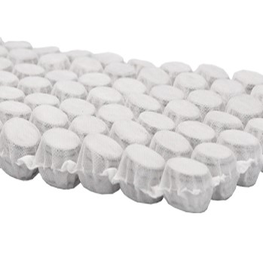
Ocean Luxury Firm 3010
Scan for
more info
Original
SUSTAINABILITY FEATURES
Recycled Cotton Fabric
The most sustainable 100% recycled yarn on the market. All waste is collected during the production process and 80% is reused.
Silk, Wool & Cashmere Blend
Naturally regulates temperature and wicks away moisture. The perfect blend is added to the quilt to keep you comfortable, cool and dry.
1872 Pocket Micro Coil
The 1,872 points of contact instantly conform to your body to reduce body impressions, provide maximum support and maintain ultimate comfort for you all night long.
Natural Latex
Oeko-Tex certified, hypoallergenic and resistant to dust-mites, mold and mildew, it conforms to your unique shape and distributes weight evenly.
Recycled Densified Fiber Pad
Made from 60% recycled bottles and provides optimal mattress support.
ADDITIONAL FEATURES
High Density Comfort Topper
An extra layer of support that provides better edge support and deep-down comfort.
Cooling Gel Quilting Foam
Oeko-Tex certified quilting foam adds pressure relief and provides more support throughout the mattress.
High Density Support Foam
Creates a firm sleeping surface and provides more support than standard foam.
High Density Foam Core
Offers long-lasting support that virtually eliminates partner disturbance, counteracts any spring effect in the mattress and provides excellent support and pressure relief.
Upholstery-Grade Foam Encasement
Permanently seals the innerspring 360 degrees around to deliver a durable, comfortable seating edge and 20% more sleeping area.
Adjustable Base Friendly
Amish Wood Foundation

Slide 11
Opal Plush
3012
Original
Designed with the finest attention to detail, every mattress in the Nature’s Spa collection features environmentally-friendly materials carefully selected to provide optimum pressure relief, temperature regulation and support.

Slide 12
Opal Plush 3012
Scan for
more info
Original
SUSTAINABILITY FEATURES
Recycled Cotton Fabric
The most sustainable 100% recycled yarn on the market. All waste is collected during the production process and 80% is reused.
Silk, Wool & Cashmere Blend
Naturally regulates temperature and wicks away moisture. The perfect blend is added to the quilt to keep you comfortable, cool and dry.
1872 Pocket Micro Coil
The 1,872 points of contact instantly conform to your body to reduce body impressions, provide maximum support and maintain ultimate comfort for you all night long.
Natural Latex
Oeko-Tex certified, hypoallergenic and resistant to dust-mites, mold and mildew, it conforms to your unique shape and distributes weight evenly.
Recycled Densified Fiber Pad
Made from 60% recycled bottles and provides optimal mattress support.
ADDITIONAL FEATURES
High Density Comfort Topper
An extra layer of support that provides better edge support and deep-down comfort.
Cooling Gel Quilting Foam
Oeko-Tex certified quilting foam adds pressure relief and provides more support throughout the mattress.
High Density Foam Core
Offers long-lasting support that virtually eliminates partner disturbance, counteracts any spring effect in the mattress and provides excellent support and pressure relief.
Upholstery-Grade Foam Encasement
Permanently seals the innerspring 360 degrees around to deliver a durable, comfortable seating edge and 20% more sleeping area.
Adjustable Base Friendly
Amish Wood Foundation

Slide 13
Oakley Euro Top
3014
Original
Designed with the finest attention to detail, every mattress in the Nature’s Spa collection features environmentally-friendly materials carefully selected to provide optimum pressure relief, temperature regulation and support.

Slide 14
Oakley Euro Top 3014
Scan for
more info
Original
SUSTAINABILITY FEATURES
Recycled Cotton Fabric
The most sustainable 100% recycled yarn on the market. All waste is collected during the production process and 80% is reused.
Silk, Wool & Cashmere Blend
Naturally regulates temperature and wicks away moisture. The perfect blend is added to the quilt to keep you comfortable, cool and dry.
1872 Pocket Micro Coil
The 1,872 points of contact instantly conform to your body to reduce body impressions, provide maximum support and maintain ultimate comfort for you all night long.
Natural Latex
Oeko-Tex certified, hypoallergenic and resistant to dust-mites, mold and mildew, it conforms to your unique shape and distributes weight evenly.
Recycled Densified Fiber Pad
Made from 60% recycled bottles and provides optimal mattress support.
ADDITIONAL FEATURES
High Density Comfort Topper
An extra layer of support that provides better edge support and deep-down comfort.
Cooling Gel Quilting Foam
Oeko-Tex certified quilting foam adds pressure relief and provides more support throughout the mattress.
High Density Foam Core
Offers long-lasting support that virtually eliminates partner disturbance, counteracts any spring effect in the mattress and provides excellent support and pressure relief.
Upholstery-Grade Foam Encasement
Permanently seals the innerspring 360 degrees around to deliver a durable, comfortable seating edge and 20% more sleeping area.
Adjustable Base Friendly
Amish Wood Foundation

